Slide 1
Hybrid microbiome analysis
Jochum, Michael D
12 March 2020
Container Camp 2020

Slide 2
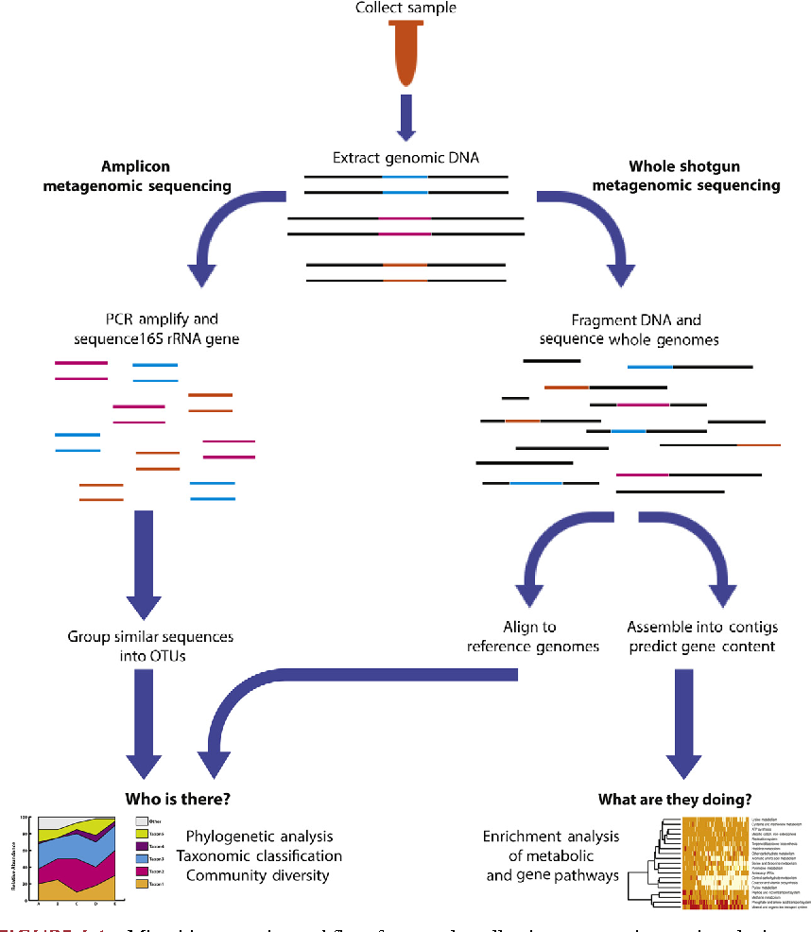
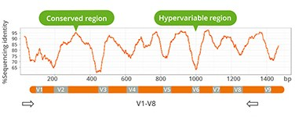
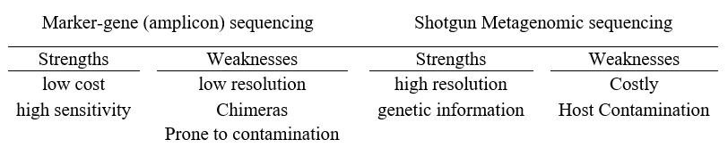
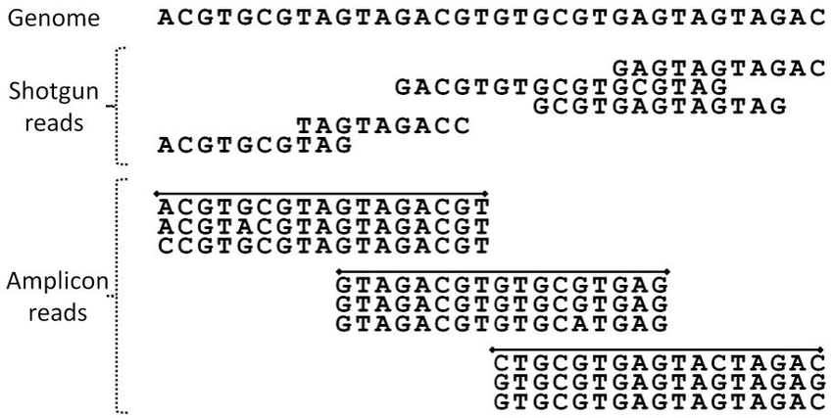
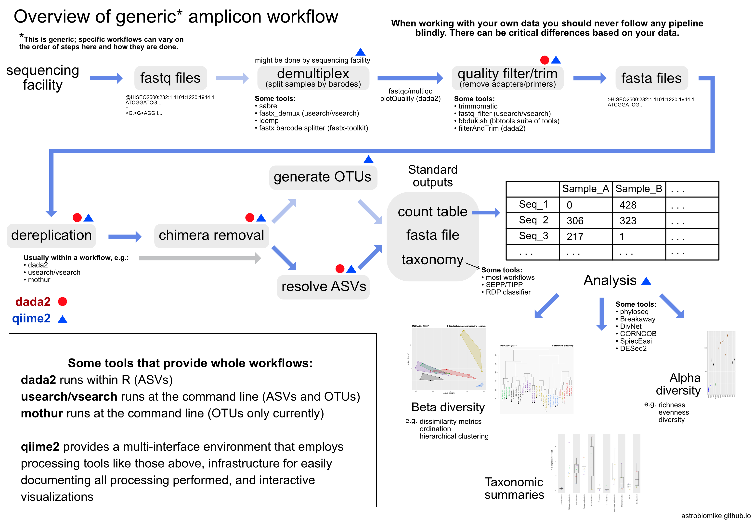
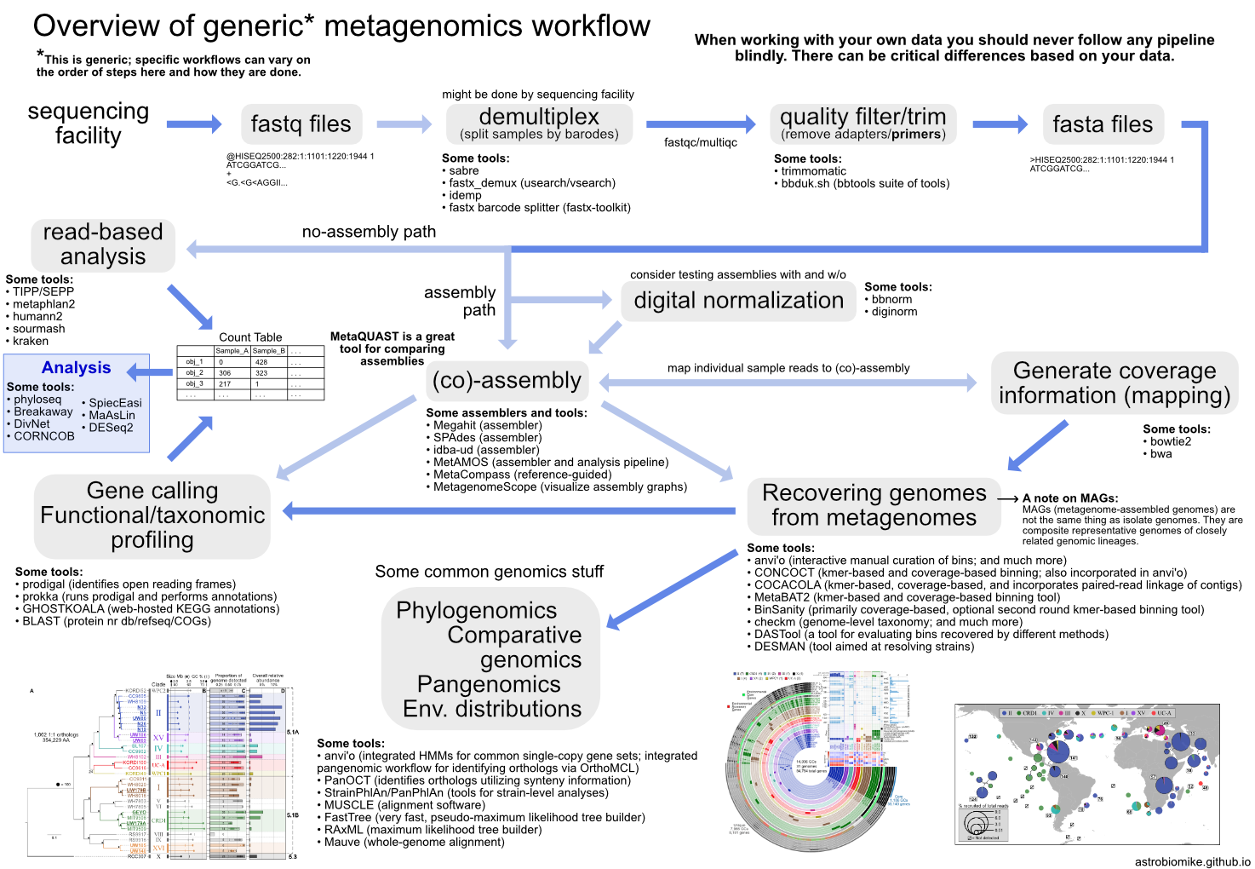
https://www.semanticscholar.org/paper/The-Human-Microbiome-Meisel-Grice/2da63dcac729c9e548d5ee05c61ff9ce28d1cc0a/figure/0
Notes:
Not really sure, but I have several datasets that we have run both 16S amplicon and WGS reads, and was looking for something that could utilize the sensitivity of amplicon sequencing as well as the resolution of WGS sequencing for an integrated comparative or hybrid analysis.

Slide 3
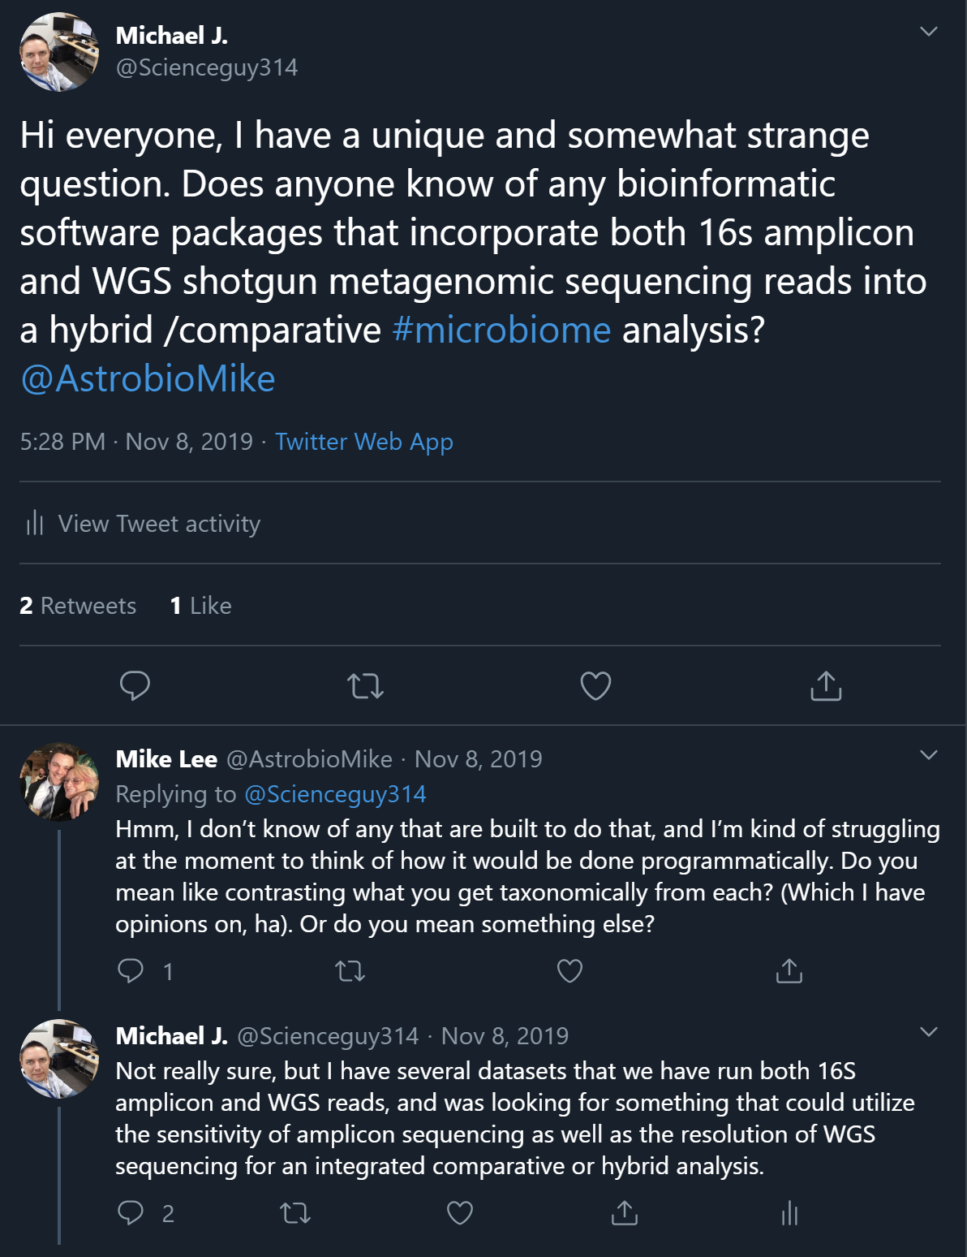
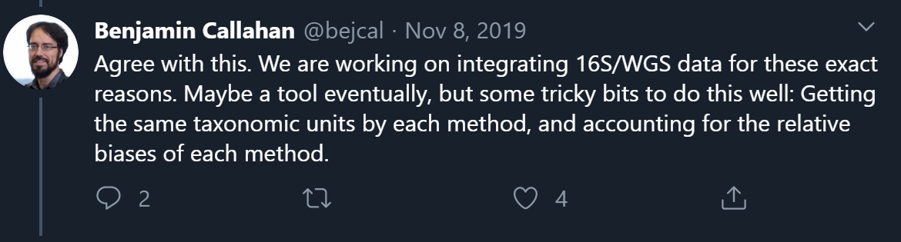
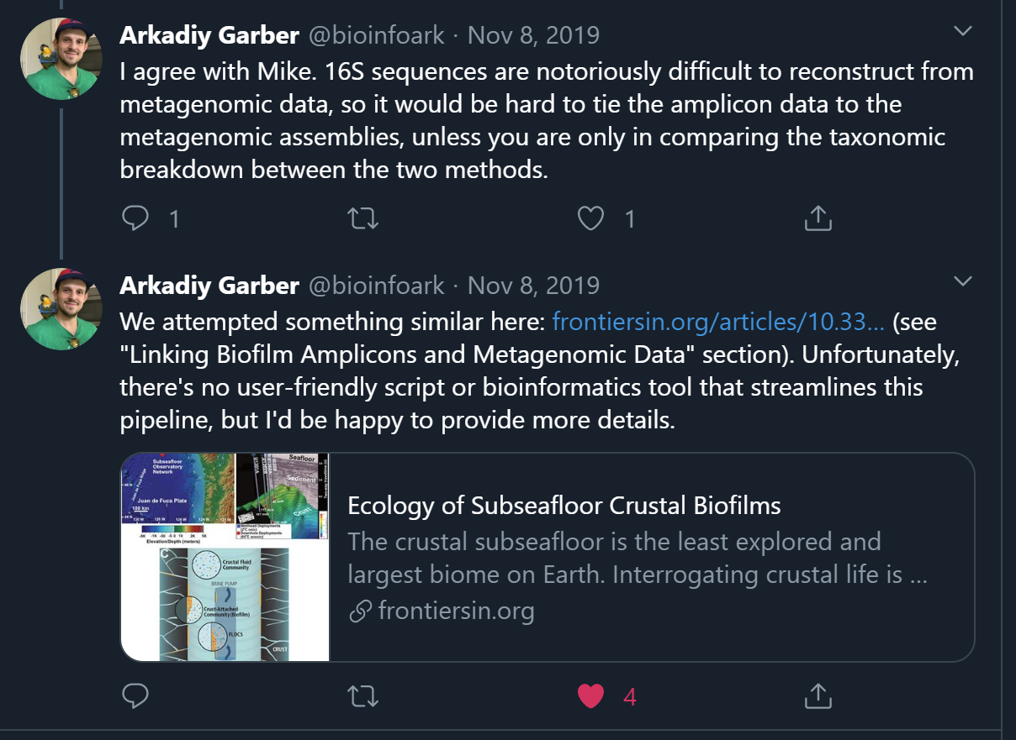
Notes:
16S data has great strength in samples that are overwhelmed with host DNA, but lack resolution and confidence at the lower taxonomic levels. WGS provides adequate resolution, but are often comprised of 99.99% host, which can mask low abundant microbiomes if not deep-sequenced.

Slide 4
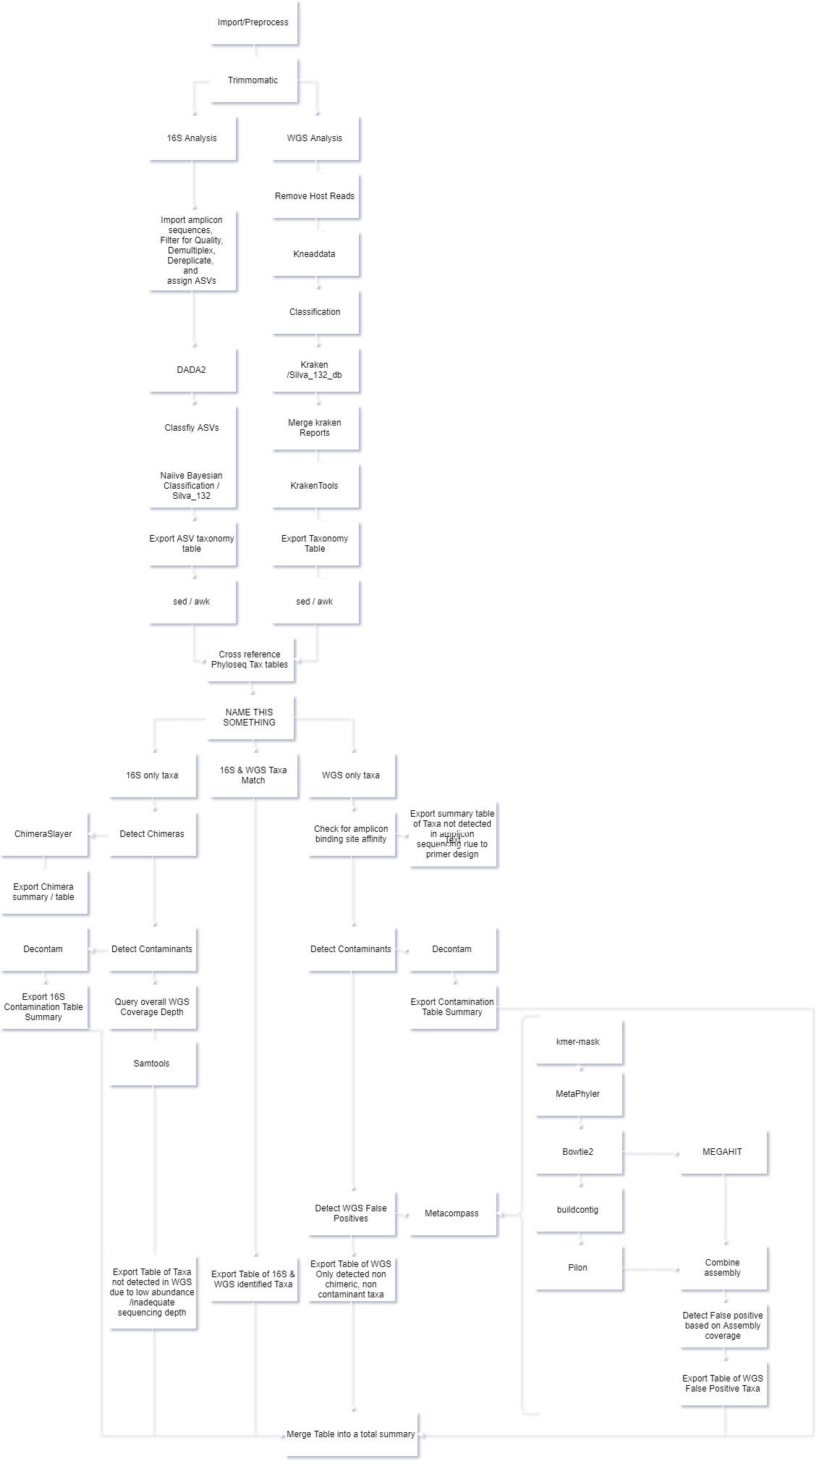
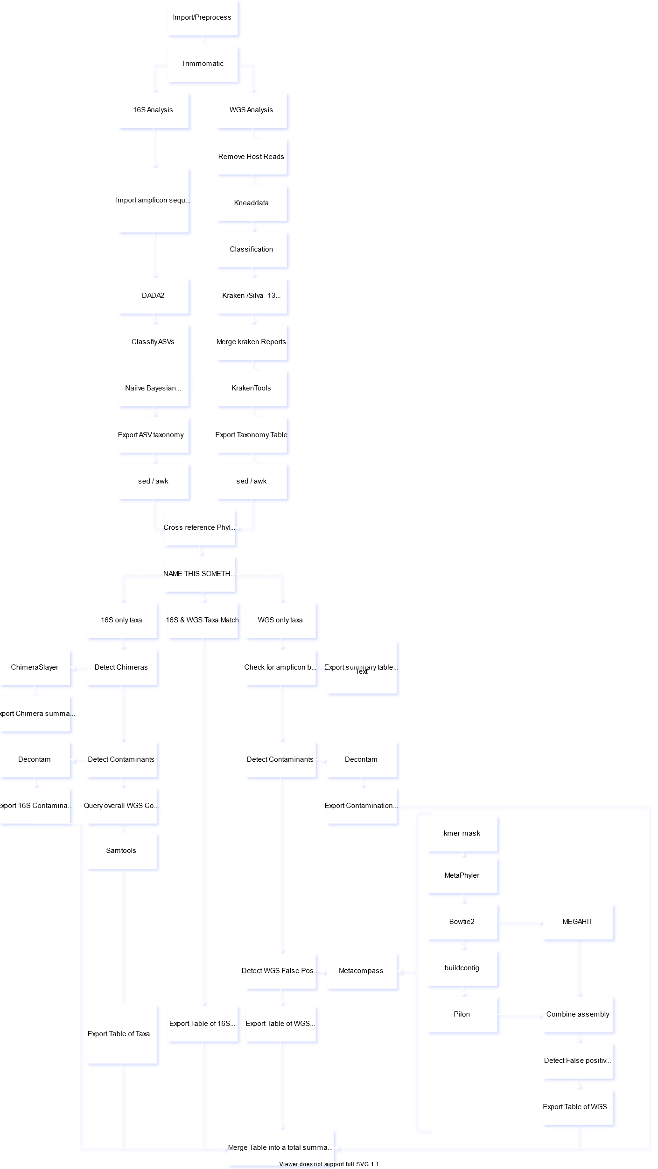
Analysis Pipeline
Interpretation Pipeline
Analysis Pipeline
Interpretation Pipeline
Notes:
16S data has great strength in samples that are overwhelmed with host DNA, but lack resolution and confidence at the lower taxonomic levels. WGS provides adequate resolution, but are often comprised of 99.99% host, which can mask low abundant microbiomes if not deep-sequenced.

Slide 5
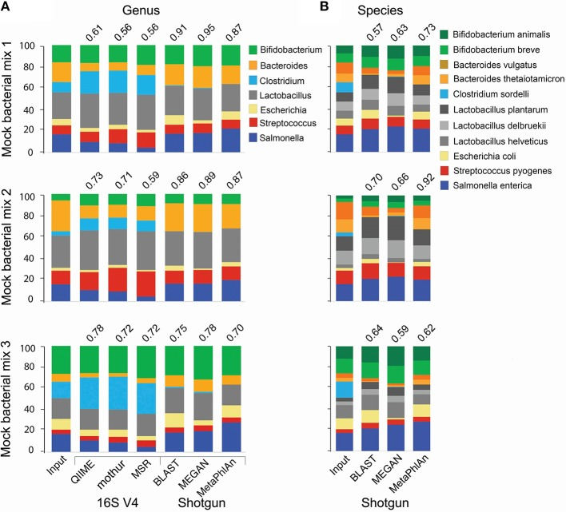
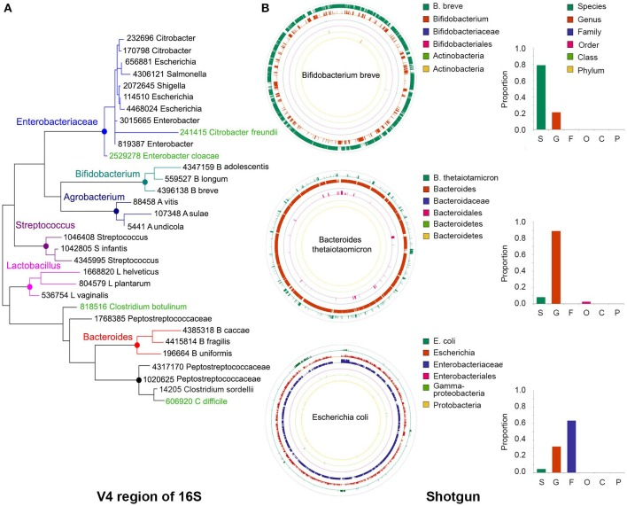
Notes:
16S data has great strength in samples that are overwhelmed with host DNA, but lack resolution and confidence at the lower taxonomic levels. WGS provides adequate resolution, but are often comprised of 99.99% host, which can mask low abundant microbiomes if not deep-sequenced.

